Slide 1

E-Library Project
Submitted By:
Nitish Kumar Mandal
Mehul Basera
Yogesh Mishra

Slide 2
Content:
INTRODUCTION
DESCRIPTION OF PROJECT
TECHNOLOGY AND TOOL USED
GLIMPSES OF PROJECT
BENEFITS
LIMITATION
CONCLUSION

Slide 3

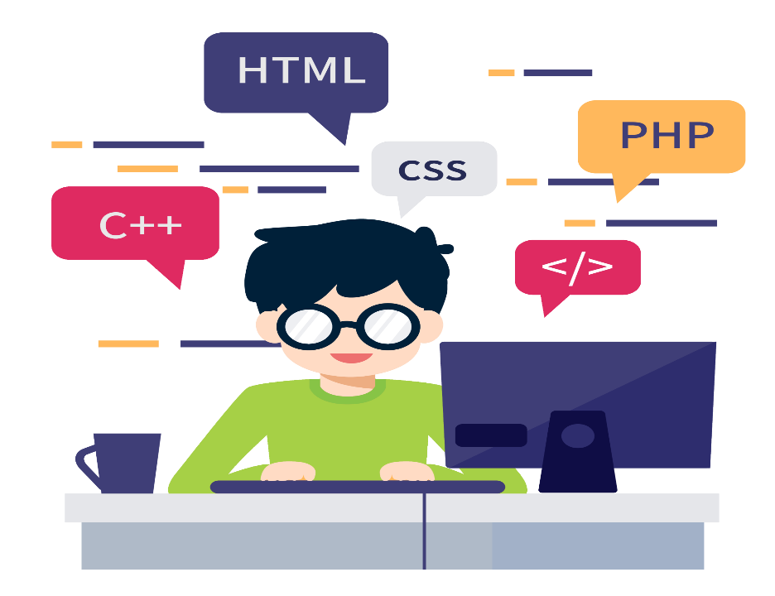
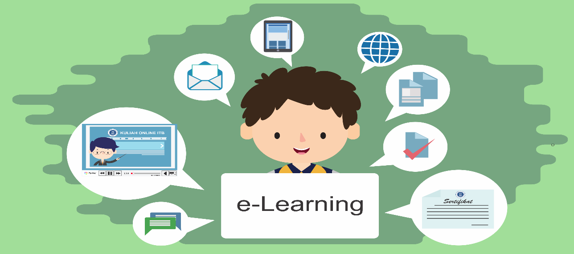
INTRODUCTION-
E-learning is widely used technology these days and the actual concept of E-learning is given in this section. E-learning can be defined as the way of learning different aspects and activities using the computers and the corresponding network connecting these computers. As per the opinion of one of the researcher, e-learning can be defined as the process of gaining the knowledge and delivering the knowledge through online methodologies and also sharing the knowledge to a remote person through online.

Slide 4


DESCRIPTITON OF PROJECT
WHY THIS PROJECT?
Notes and Assignment circulation is each semester work for any individual faculty/teacher & for a student it is difficult task to arrange them, to prepare for mid/end semester examination. So, to tackle this problem we have made the E-Library which covers information regarding Syllabus, Notes ,Assignments etc. and this website have customized interface according to your Semester/Year and Degree.
OBJECTIVES:
To make to task easier for students to get the subject related content.
Main implication of website is to motivate and help students to ace in academic assesments.

Slide 5






TECHNOLOGY AND TOOLS USED
LANGUAGES USED:
HTML
CSS
JAVASCRIPT
DEVELOPER TOOLS USED:
VS CODE
GITHUB
FIGMA

Slide 6
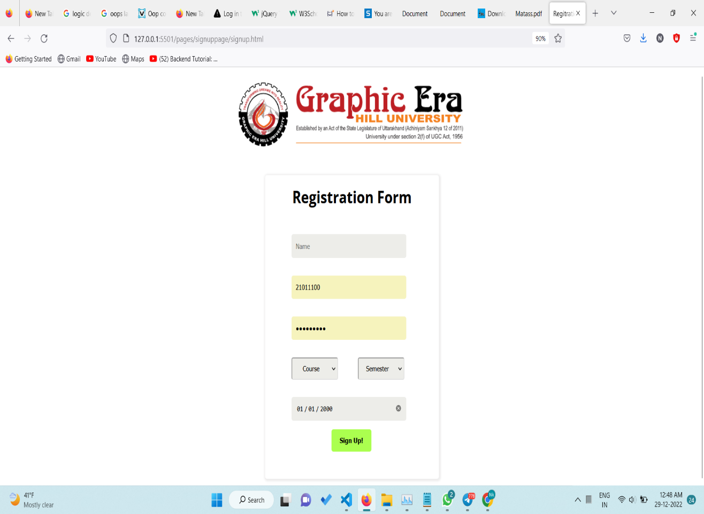
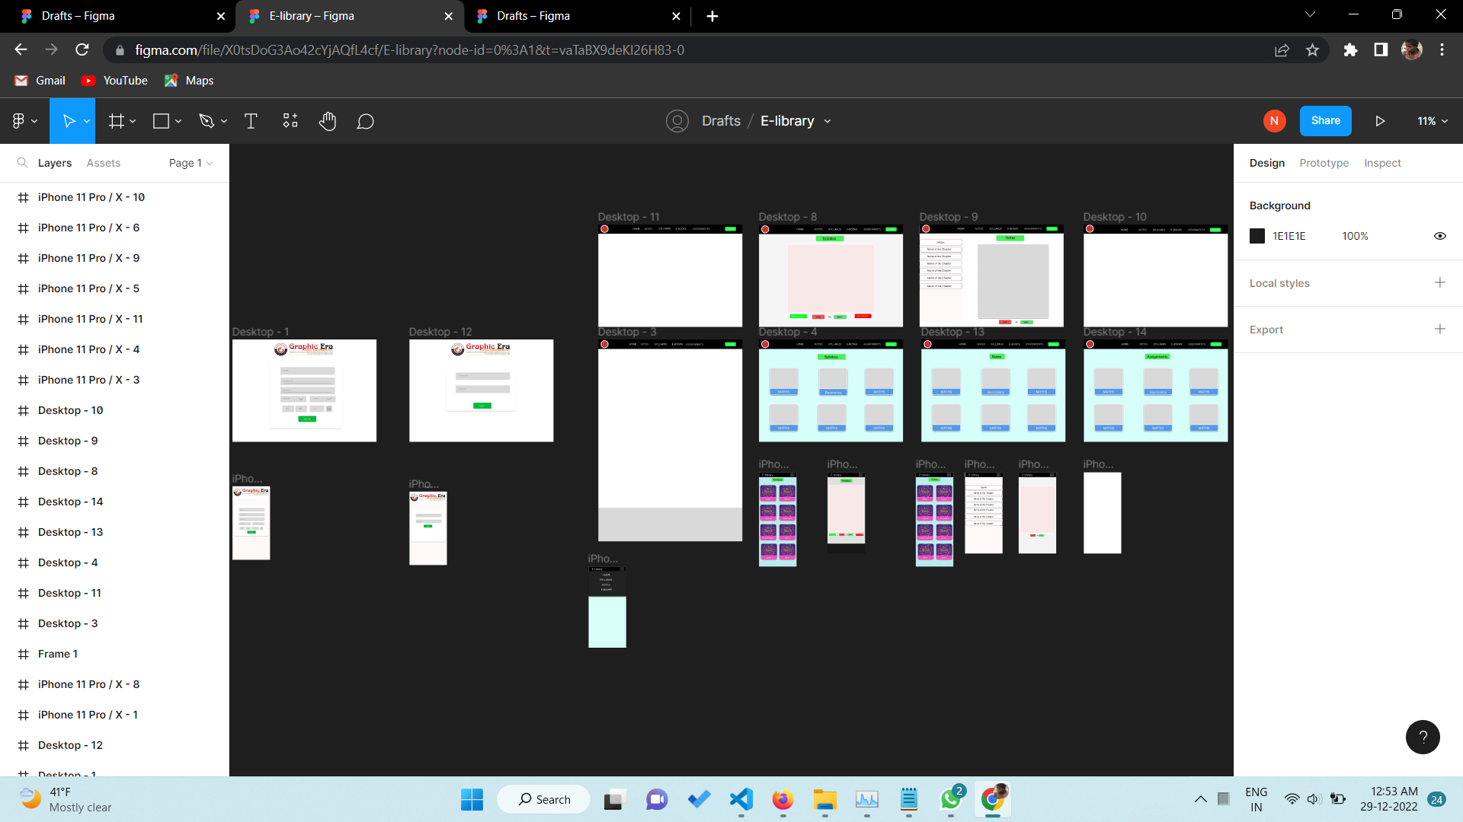
GLIMPSES OF E-LIBRARY PROJECT
REGISTRATION PAGE
FIGMA UI DESIGN

Slide 7
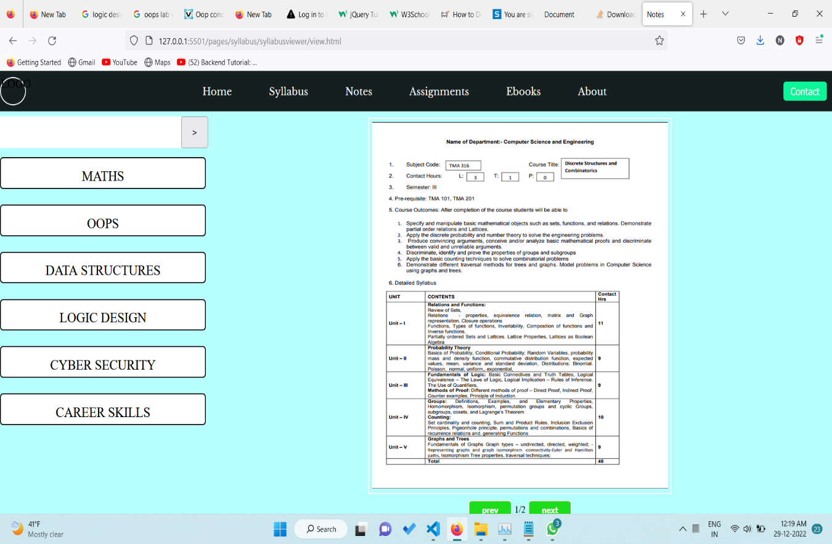
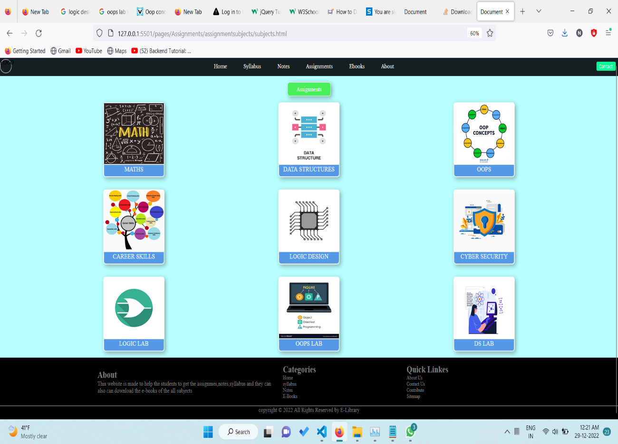
SYLLABUS VIEW
ASSIGNMENT SECTION

Slide 8


EASY TO USE
USEFULNESS OF E-LIBRARY PROJECT
DOWNLOADABLE STUDY MATERIAL
CUSTOMIZABLE USER INTERFACE
FREE TO USE

Slide 9
NOT SECURE
SHORTCOMING:
DATABASE LINKING STILL PENDING

Slide 10
THANK YOU

